Slide 1



Global Tsunami Model
Hong Kie Thio
Finn Løvholt
Stefano Lorito
Randall Leveque

Slide 2
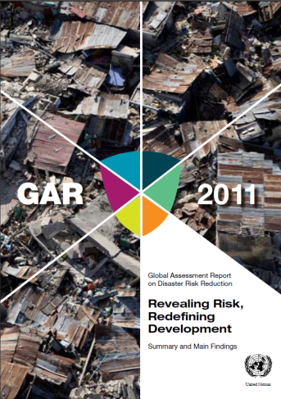

Background and motivation – why did we take this initiative?
Multi-institutional work on hazard and risk for the UN-ISDR (Global Assessment Report, GAR)
Idea: Need to gather scientific community for
Collective effort for improved understanding of global tsunami hazard and risk
Improve methods, develop guidelines and standards
Non-exclusive initiative ↔ open for the community
Initiative from the tsunami community itself
Proposers: NGI, GA, INGV, USGS, IPMA, GFZ
No owners or funding at present
GTM should ensure relevance towards stakeholders
Societal relevance
Ambition will – to a considerable extent – depend on success in attracting external funding

Slide 3
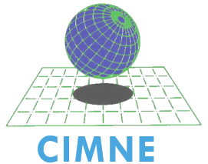
























Interested organizations: > 20 Researchers: > 70 researchers
Norway
Italy
Spain
USA
Australia
New Zealand
Turkey
France
Japan
Indonesia
Germany
Russia

Slide 4
Meetings and dissemination activities so far
IUGG Prague June 2015
Proposed in public GTM presentation
Scoping meeting discussing the science content
Discussions with IOC UNESCO TOWS group on tsunami hazard assessment and probability vs defining largest credible magnitudes
AGU December 2015 – OAKLAND (AECOMs office)
Discussing organizational structure
Exchange knowledge and experience from GEM
Establishment of workgroups
UNISDR S&T conference January 2015 – GTM poster (NGI)
OASIS Loss Modeling Framework – webex meeting April 2015 (NGI, INGV, CIMNE)
EGU 2016
SSA 2016(this meeting)

Slide 5
Overall objectives (1)
Probabilistic tsunami hazard and risk (and related disciplines)
Develop standards and guidelines
Harmonize efforts and products
Develop tsunami hazard and risk (and related) products
Integrate datasets from other providers, or, compile databases where non-existent
Methods verification (simulation tools, hazard and risk related tools)

Slide 6
Overall objectives (2)
Provide reference hazard and risk data on regional and global scale based on standardized and benchmarked methodologies
Enable compatibility between regional and local scale hazard and risk products
Utilize and harmonize projects outside GTM – examples:
TSUMAPS-NEAM regional hazard maps for the Mediterranean
Generic tools for interfacing models Tsunami API – GNS Science
Run and facilitate own projects and activities – based on funding
Facilitate integration of results and tools from related organizations such as GEM and GVM – and assign borderlines

Slide 7
Examples of current approaches to PTHA
AECOM, Geoscience Australia
Two step process (offshore -> disaggregation -> inundation)
ASCE 7-16, State of California, Indonesia, Australia, GAR2015
University of Washington
Scenario-based (direct inundation)
Washington State
Crescent City
GNS
Monte Carlo (direct inundation)
New Zealand
Notes:
Will include summaries and some example figures

Slide 8
Framework of methods and common interfaces
Notes:
Red boxes represent input/output for which we would like to develop common format or translation modules between formats

Slide 9
Relation with other initiatives
Coordination with
TSUMAPS-NEAM (tsunami hazard in the NE Atlantic and Mediterranean region)
GEM (earthquake source models)
GVM (volcano models)
Related activities
S4Slide (Submarine landslides)
ICL (Landslides)
ASCE 7-16 – Probabilistic Design Standards for Tsunami
NTHMP – Validation of tsunami codes
PEER Tsunami program – Development of aleatory variability
SCEC Broadband platform – Stochastic source models
Seismic Vulnerability and fragility
Dissemination and geoethics (transparency – uncertainty communication)

Slide 10
Some simple tools available at present
Simple GTM webpage set up by UW
www.globaltsunamimodel.org
GitHub repository for files set up by UW
https://github.com/GlobalTsunamiModel/GlobalTsunamiModel.github.io
GTM google group (including GEM and GVM) – set up by AECOM
https://groups.google.com/forum/#!forum/globaltsunamimodel
Further suggestions by Randy LeVeque in the GTM googlegroup
Some PTHA tools on github provided by GA
The above structures are preliminary – and also allow us to explore possibilities – what do we need - prior to building more extensive and complete infrastructure

Slide 11
Focus on three basic activities
Committing partners to the GTM, through a simple process
Acquiring signed Letters of Intent (LoI’s) from own Institutions, enabling Point(s) of Contact for each Institution; Initial “loose” commitment toward GTM construction
Seeking for endorsement
Main Contact established with UNISDR; other agreements ongoing
joint White Paper, possibly on a top Journal showing
Commitment
Endorsement
GTM added value (standards, validation, tools, a unique broad community)

Slide 12
Near future
Keep working in common (pilot) Projects, e.g. TSUMAPS-NEAM, allows defining explicit scope and focus areas where we need standards
Refine verification practices/tools (e.g. weighting of alternative models through elicitation of experts; sanity checks; comparison with observations)
Initiation of preparation of Terms of Reference (ToR)
Follow up workshop with re-insurance industry

Slide 13
For a later phase (and related to ToR)
Coordination, Scientific and advisory boards
Will depend on interaction with stakeholders
Structure/Location of secretariat
Management of joint funding
Decisions on size and structure of membership fee
Open source and IPR issues
Engagement with national authorities

Slide 14
Interested? Hong Kie Thio - hong.kie.thio@aecom.com Finn Løvholt - finn.lovholt@ngi.no Stefano Lorito - stefano.lorito@ingv.it

